Slide 1


Integrating Science and Social Studies into the ESL Classroom
Heather Turngren Minneapolis Adult Education
Erin Cary
Lyndale ESL Program & Minnesota Literacy Council

Slide 2

Objectives:
Participants will be able to….
Articulate several reasons for including Social Studies and Science content in intermediate and advanced ESL instruction.
Identify ways to integrate Social Studies and Science content into existing units of instruction.
Develop a lesson or activity with Social Studies objectives.
Develop a lesson or activity with Science objectives.
Access instructional resources for teaching Social Studies and Science content/practices.
Develop a plan to integrate appropriate academic language and strategies for its use in the ESL classroom.

Slide 3

Who are we?
One-room school house
Multi-level ESL/ELL/ESOL
classroom
Core Literacy ESL/ELL/ESOL
Family Literacy
Basic Skills/ABE/GED/
College Prep/Adult Diploma
Corrections facility
Tutoring/drop-in setting
Volunteer coordinators
Managers/administrators
Other?

Slide 4
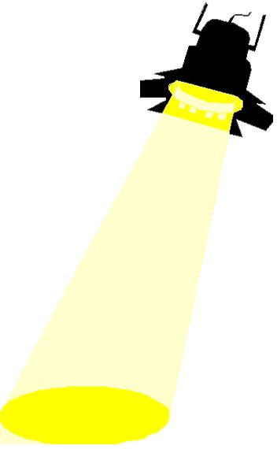
Why Integrate Social Studies and Science in ESL?
CCRS (College and Career Readiness Standards)
ACES
GED® 2014
Minnesota Adult Diploma
College Readiness Academy (new initiative)
College Preparation
Training for Employment in Industry
Social Studies Spotlight:
Citizenship
High Interest Reading Comprehension
Background for New Americans

Slide 5
Academic Language
Why teach it in these contexts?
Applied in a meaningful way
Connected to content area
Building prior knowledge for future goals

Slide 6
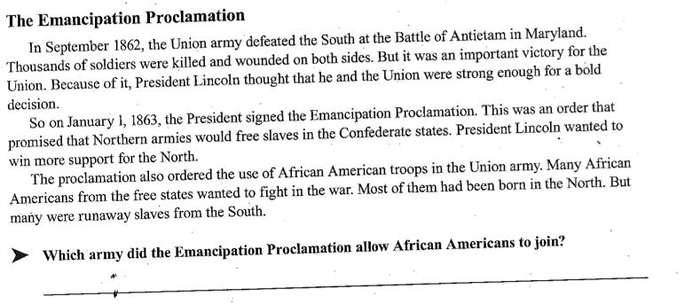
Compare and Contrast
Academic Language
Conflict
Injure
Significant
Stable
Resolution
Liberate
Assistance
Legislation

Slide 7
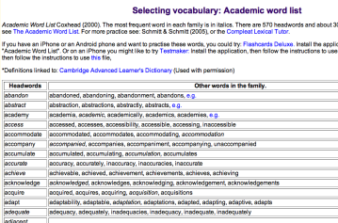
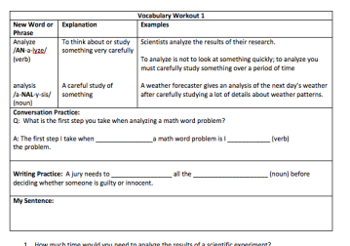
Academic Word List Sources
Online AWL
Vocabulary Workouts

Slide 8
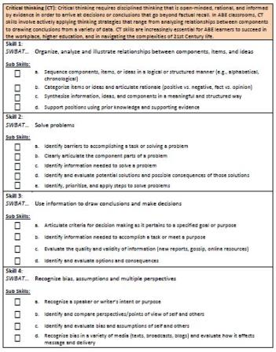
TIF Matching Activity
TIF: Critical Thinking
Social Studies Activities
Match the example activities to corresponding critical thinking skills and sub-skills listed in the Transitions Integration Framework.

Slide 9

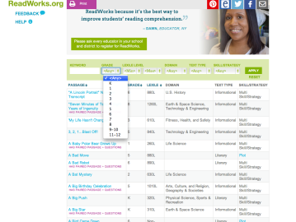
ReadWorks.org
Search by Topic
Search by Reading Level

Slide 10

Zaption.com

Slide 11
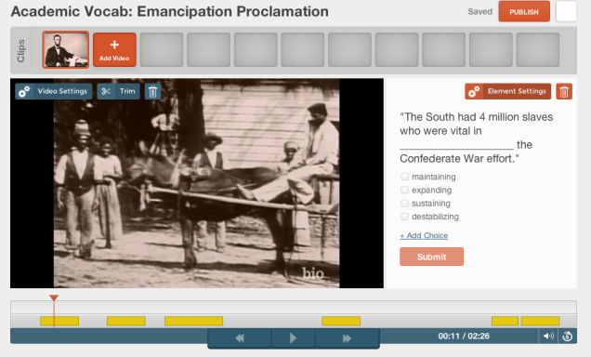
Zaption.com in Use

Slide 12
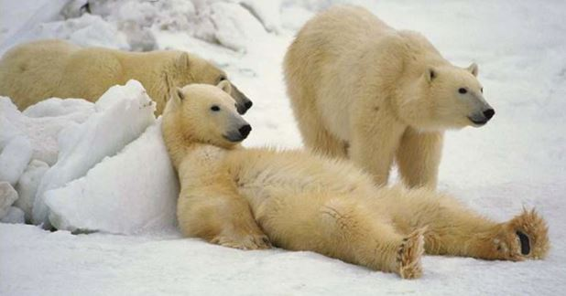
Break!

Slide 13
Why Integrate Social Studies and Science in ESL?
CCRS (College and Career Readiness Standards)
ACES
GED® 2014
Minnesota Adult Diploma
College Readiness Academy
College Preparation
Training for Employment in Industry
Science Spotlight:
Engaging, Uses Different Learning Styles
Hands-on Learning
Teaches Problem-solving
Focuses on Evidence

Slide 14
TIFed Scientific Method

Slide 15
Scientific Method
Surface Tension Experiment

Slide 16
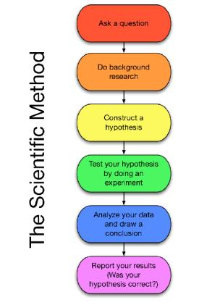
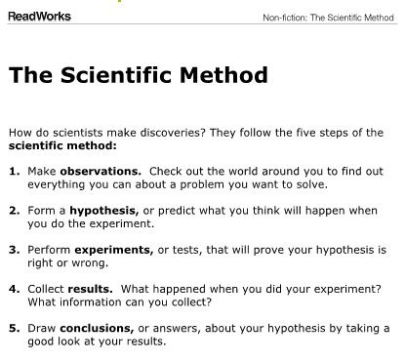
The Scientific Method =
5 or 6 Steps ?

Slide 17
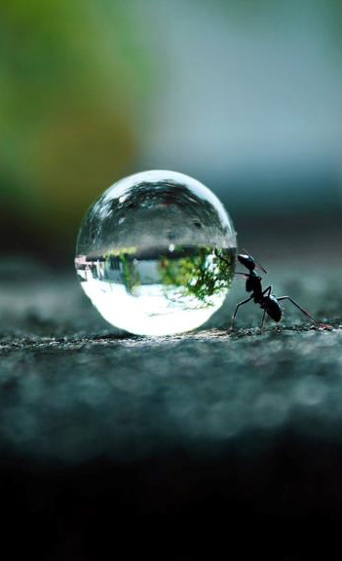
Step 1: Observe and ask a question
“How does a drop of water stay together?”

Slide 18

Step 2: Do background research
From the Internet:
It seems that the water droplet has a “skin” holding the water together. This “skin” is called surface tension and it is the result of water molecules being attracted to one another.

Slide 19

Step 3: Construct a hypothesis
(a possible answer to our question)
“Water droplets stay together due to the strong attraction of water molecules to each other.”

Slide 20
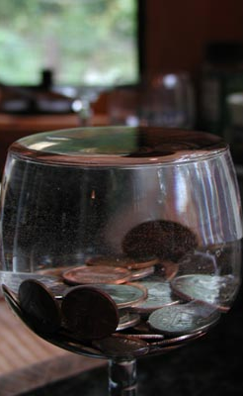
Step 4:
Test the hypothesis with an experiment
We will add pennies to a glass of water to see how many it takes to break the surface tension.

Slide 21

Step 5: Analyze the data and draw a conclusion
Work with the results of the experiment to find a conclusion.

Slide 22

Step 6: Report your results or findings
Share your results or findings with others.

Slide 23
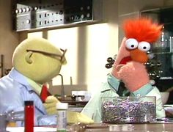
Let’s Try It!

Slide 24
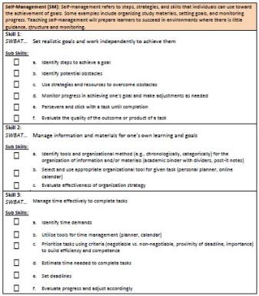
TIF Matching Activity
Science Activities
TIF: Self Management
Match the steps in the science experiment we did to corresponding self management skills and sub-skills listed in the Transitions Integration Framework.

Slide 25
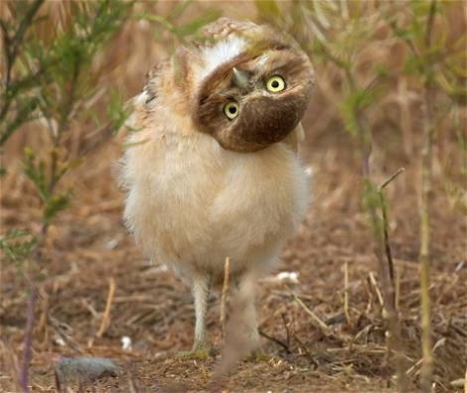
Questions? Comments?

